Slide 1
Auto Intensity Control of Street Lights
Tushar Pharale 259
Ujwal Kumar 260
Usman Khan 261
V.K Saketh 263

Slide 2
Overview
Functionalities
Multiple design solutions
Block Diagram
Circuit Diagram
Component Specification
Methodology
Applications
Future Scope

Slide 3
Functionalities
Turn on the street light only if a vehicle is detected.
Turn it off once there is no vehicle.
Don’t turn on the street lights in the day time.

Slide 4
Multiple Design Solutions
Infrared sensors can be replaced with Ultrasonic sensors
LDR sensor can be replaced with a clock
If a PIC microcontroller is used then it has an analog pin which gives more accurate results from the sensors.

Slide 5
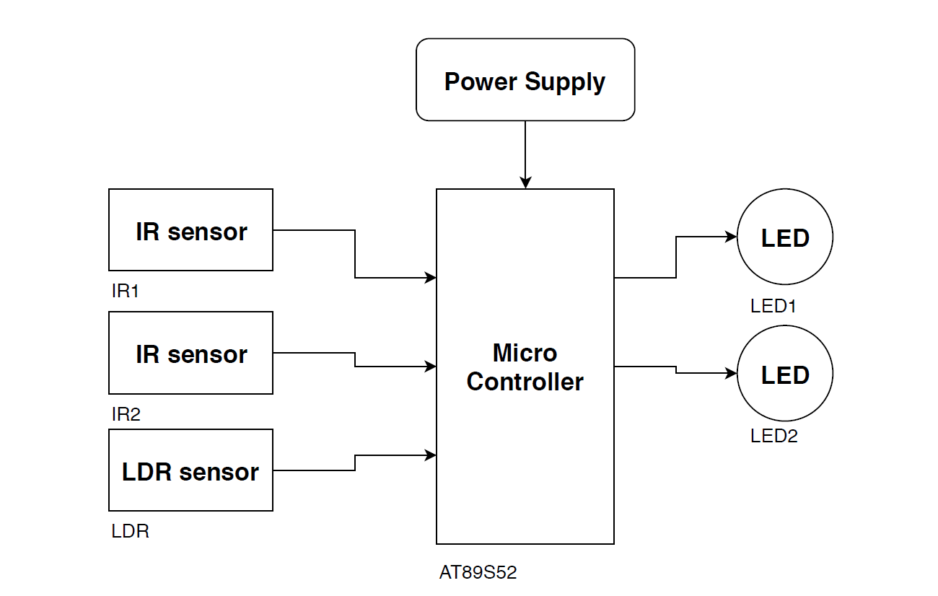
Block Diagram

Slide 6
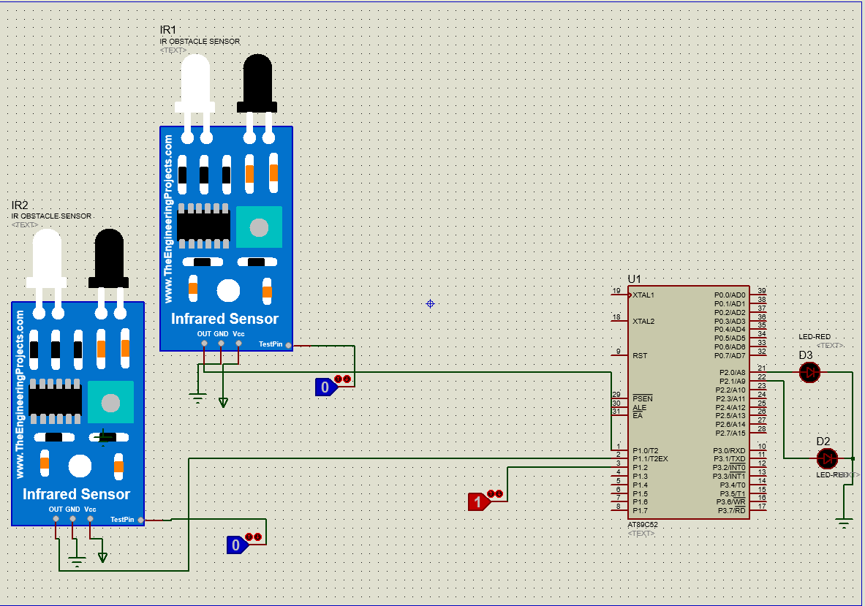
Circuit Diagram

Slide 7
Component Specification
IR sensors :
5V DC input, upto 20 cm range, Adjustable sensing range.
Pins
Vcc - 5V
GND
D0- Digital output pin 1. D0=0 when object is detected
2. D0=1 when there is no object

Slide 8
LDR sensor
5V DC input, Adjustable sensing range
Pins
Vcc- 5V
GND
D0- Digital output D0=1 when light reaches a preset level
D0=0 when there is no light

Slide 9
AT89S52
Specifications:
Has 4 ports (32 I/0 lines)
3 timers/counters
8 interrupt sources
2 DPTR registers
8K flash memory and 256 bytes of on chip RAM

Slide 10
Methodology
There are two street lights with IR sensors for each one of them to sense the object(car). When the object comes under the range of IR sensor the sensor sends a signal to microcontroller which in turn makes the street light(LED) turned on and when there is no object the LED turns off, thus saving a lot of power. This happens only in the night time or when the intensity of light is low. This is ensured by LDR(Light Detecting Resistor) module. So in the daylight the street lights will never be turned on.

Slide 11
Applications
Generally, streetlights on the highways are designed with high intensity lamps that consumes more energy and also cannot be changed as per the requirement. Thus, the proposed system overcomes these problems by using LEDs instead of HID lamps in the street light systems. So the light can be turned on only when there is an obstacle else turn it off. It also turns on the light in the night time only and not in the daytime.

Slide 12
Future Scope
Thank You

